Slide 1
GK02 – Smart Environment monitoring and Cloud streaming
James Hanna

Slide 2
What’s the project all about?
An investigation into what smart sensors can be used for to monitor our environments
Prove how IoT devices can be used with ML to identity known and unknown individuals
Demonstrate how cloud streaming can be utilized in unison with IoT devices
5/24/2023

Slide 3
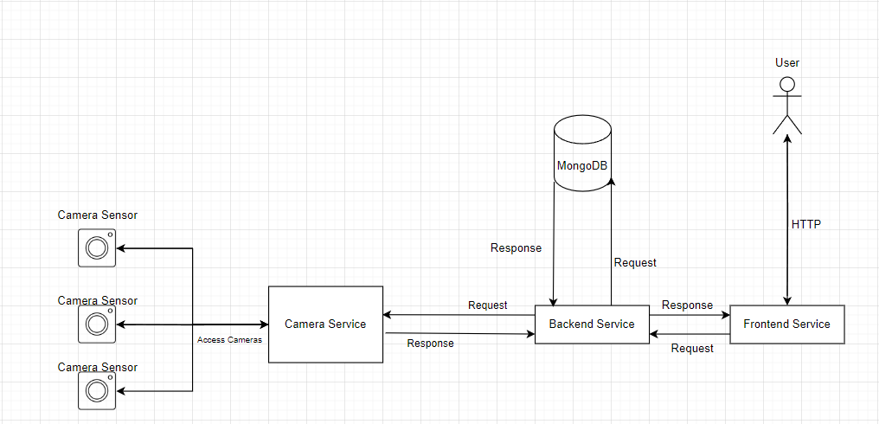
Design Plan

Slide 4
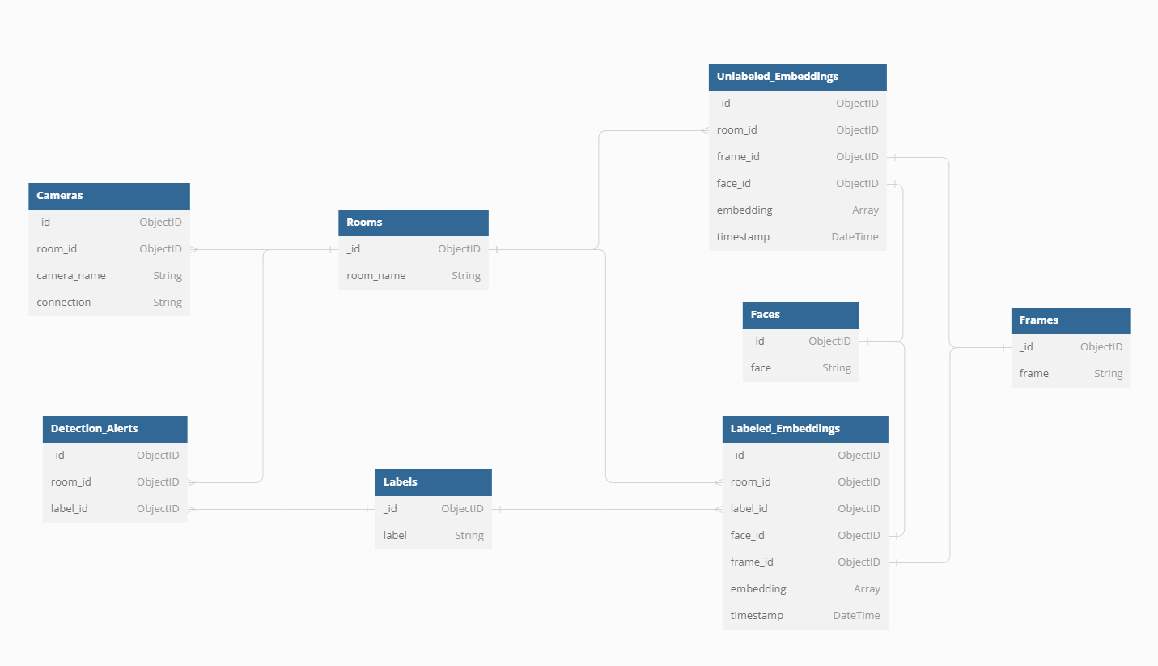
Design Plan

Slide 5
How can the project be used?
Provide security and control to our homes and our businesses, or help parents monitor children
Show the live locations of known and unknown individuals
Access the movement histories of people
Send out tailored alert messages upon the detection of a specific person
5/24/2023

Slide 6




Technologies being used
Frontend Service
Cameras Service
Backend Service
5/24/2023

Slide 7
Demo!

Slide 8
Future Ideas
Dockerize the Camera Service so it can be run in the cloud on more powerful GPUs and CPUs
Train the Camera Service using images stored in the MongoDB rather than locally
AJAX call all frontend features
Add more sensors for ideas such as turning out lights when nobody is in the room or only using facial detection algorithms when movement is detected to conserve energy
Improve detections on difficult cases such as headphones, masks etc.
5/24/2023

Slide 9
Thank you

